Slide 1
Database Project
Kaden Hicklin
Group 11
Source Code : https://github.com/khicklin23/FullStackDataBase/blob/main/StockTrader/stockDB.py
If you download the libraries and connect it to your local database you can also run it! Window formatting might be wonky though
I went through it and labeled every function with basic explanations as well as various labels.
The SQL triggers and stored procedures + table creations will be later on but the source code has a lot sql code in it.

Slide 2
Who’s it for?
Stock traders, ai / bot stock trader experimenting, pattern recognition testing
All testing is risk free but also need a method of storing large sets of data.

Slide 3
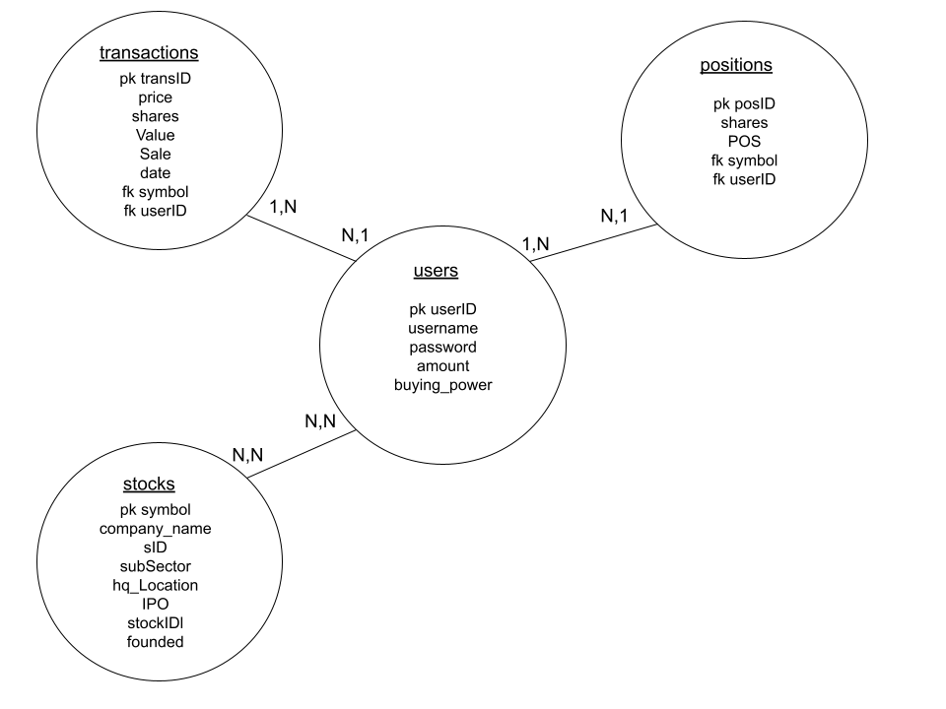
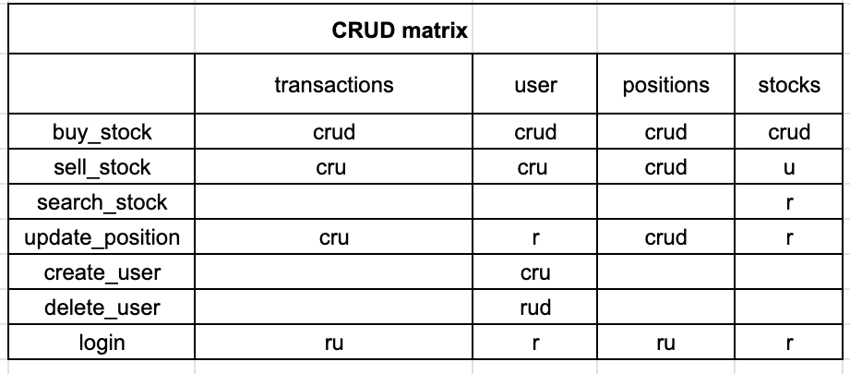
ER Diagram and Crud Matrix

Slide 4
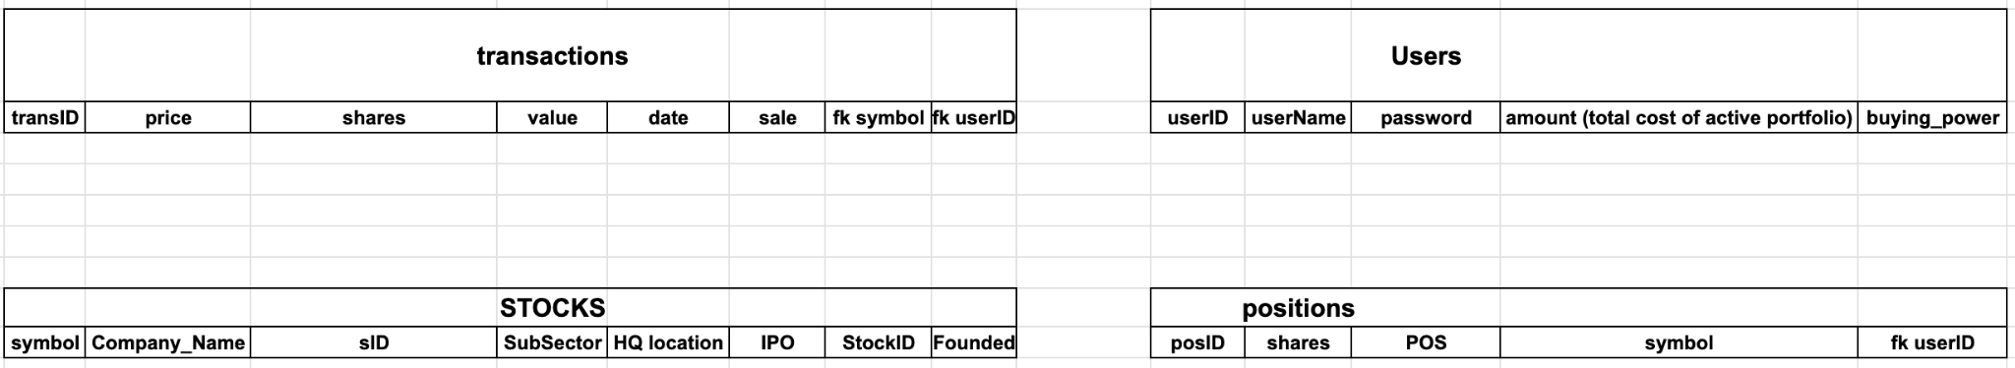
Relational Schema

Slide 5
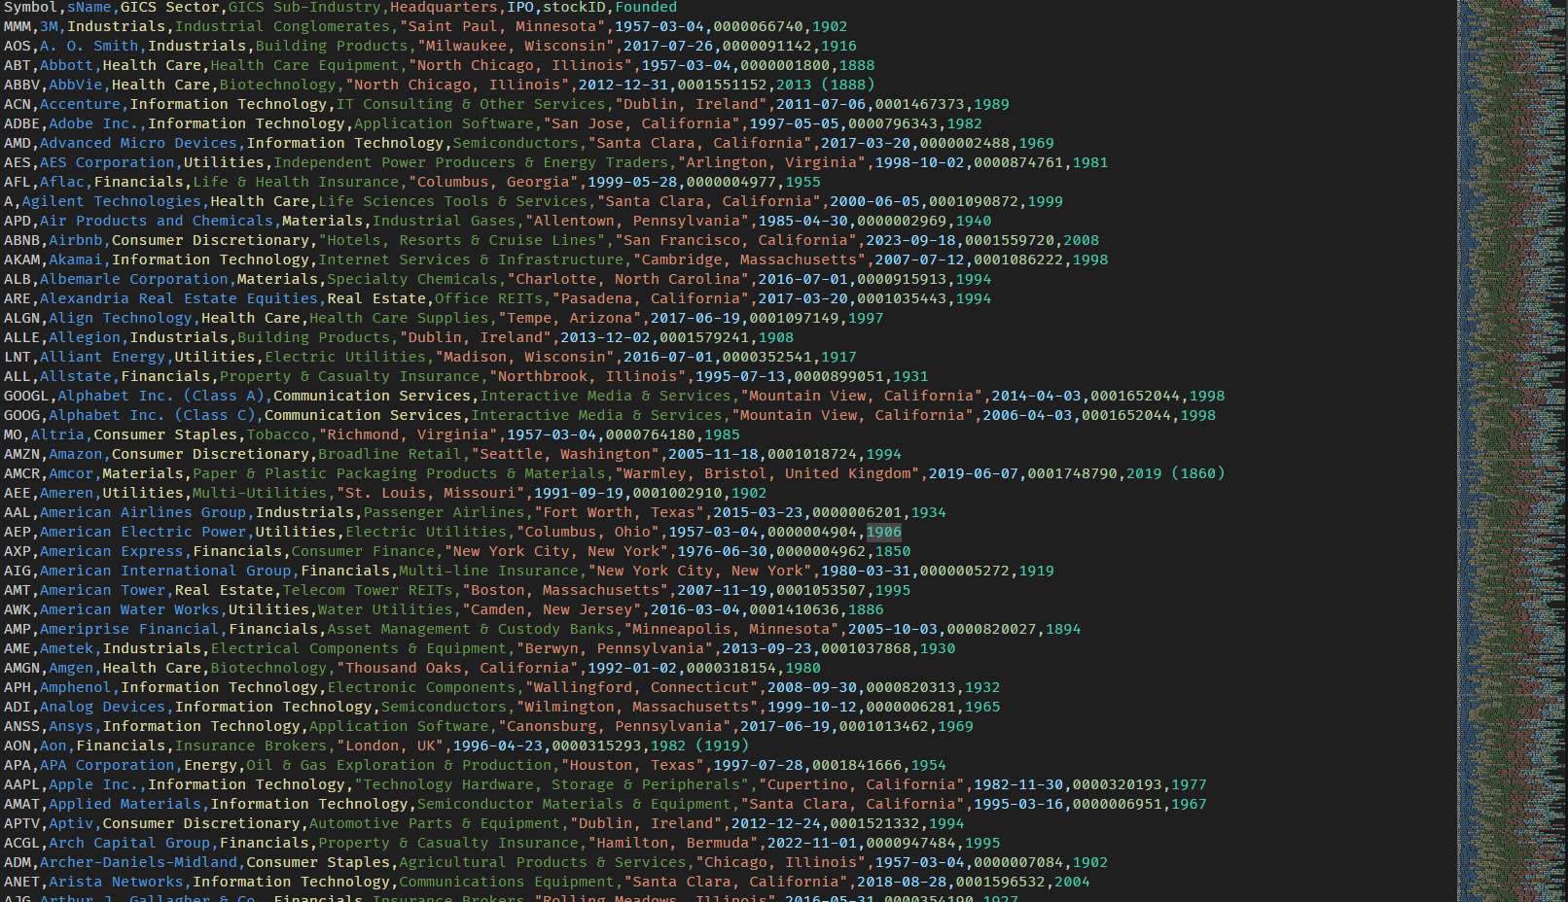
Example of the web-scraped data into csv before being inserted into stocks table

Slide 6
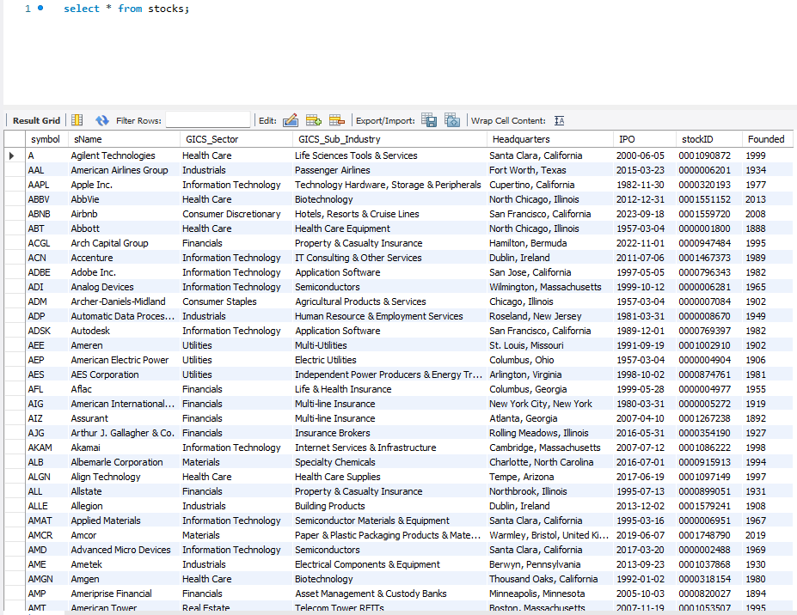

Slide 7
Example of all the tables
Here’s what all of the tables inside the database look like whenever everything is up and running (Smoothly)

Slide 8
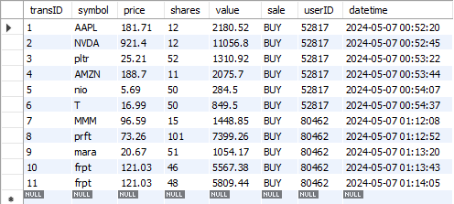
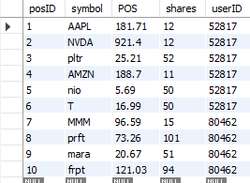
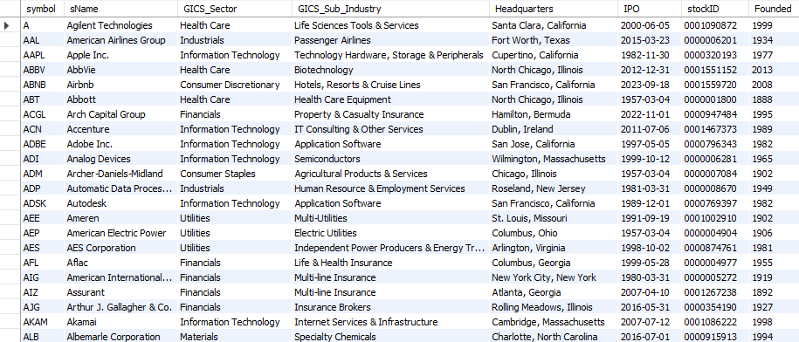

Positions Table
Transactions Table
Stocks Table
Users Table
Note: amount = user’s market value

Slide 9
How does it work?
Text explanation: It uses a web-scraping bot to scrape live stock pricing from HTML code online then it relays that data with information within the database accessed by the python code which also interprets, analyzes, and compares the data

Slide 10
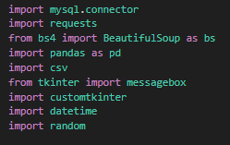

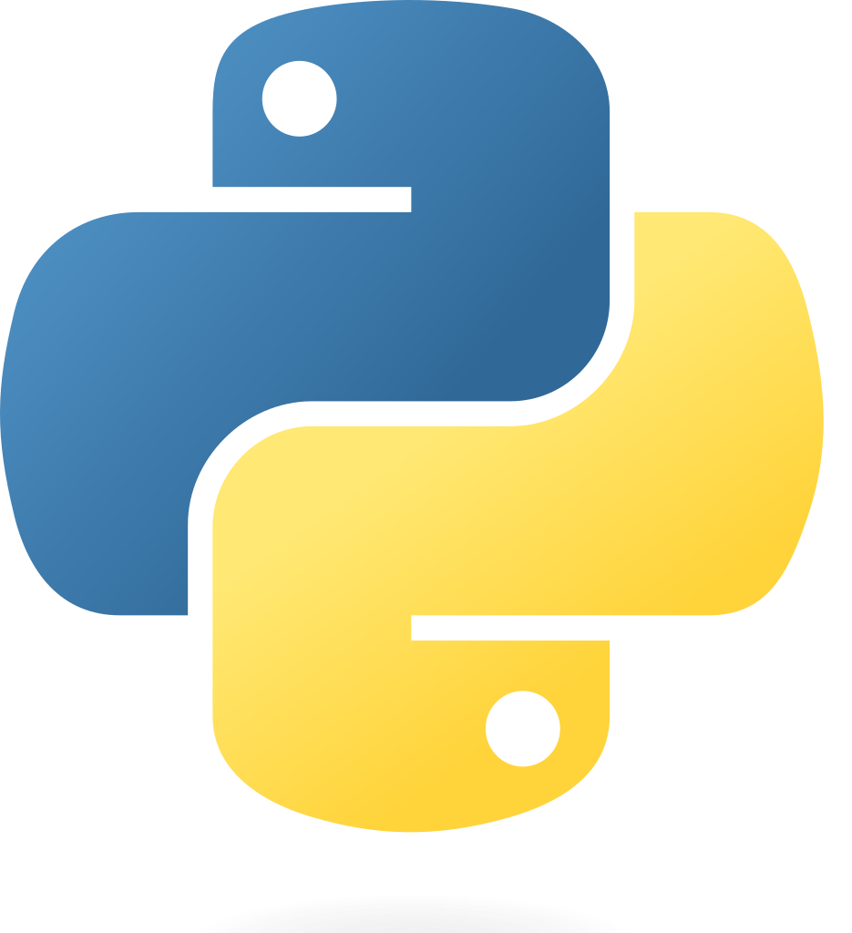

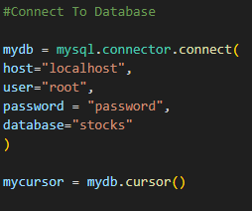


Tools:
mysql.connector

Slide 11
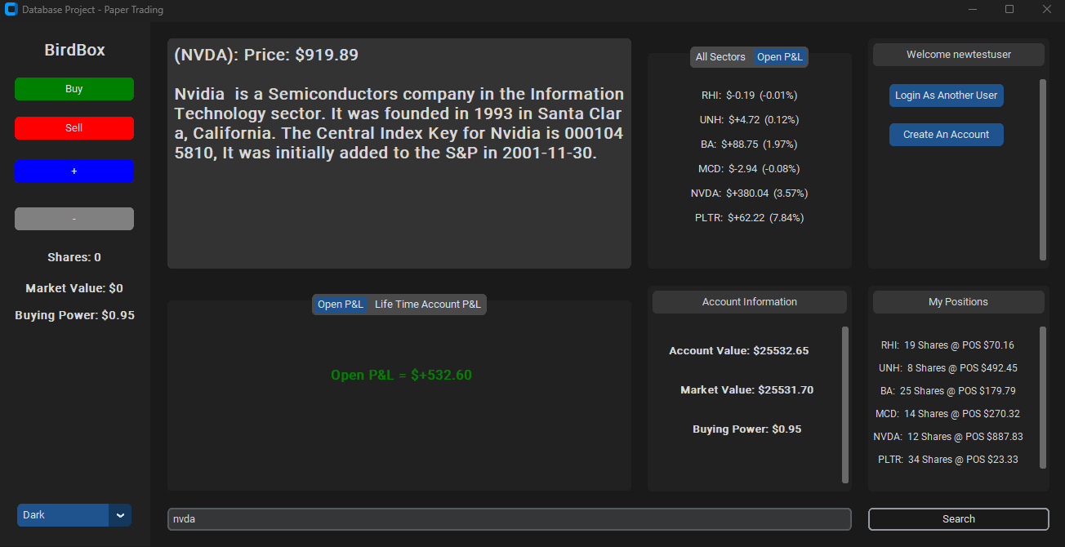
s
Stock Searched

Slide 12
User Login / Non Log in
Users are still able to view live stock data and sector updates prior to logging in but need to login to view their own specific position and portfolio updates

Slide 13
(Order of execution: Green, Red, Blue)

Slide 14
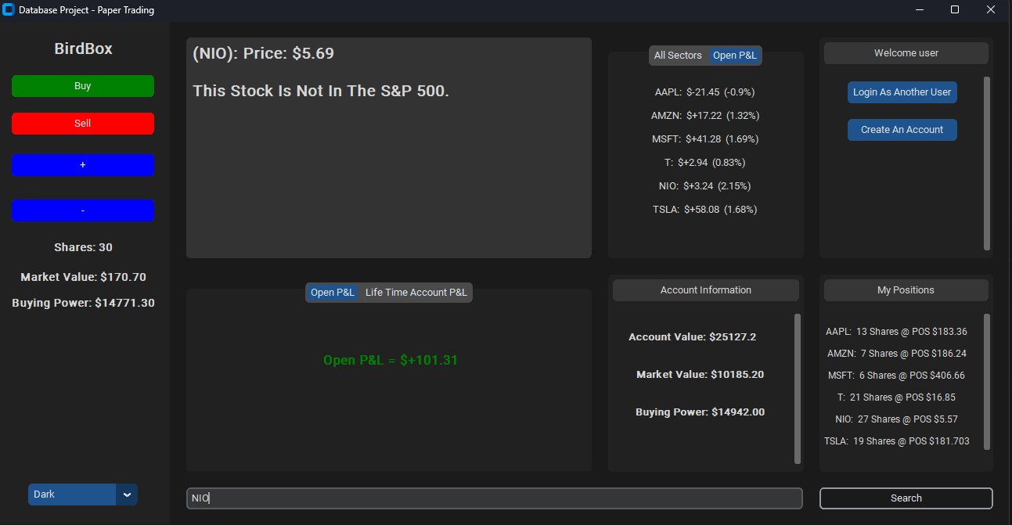
POS Averaging 10 Shares @ $20.0 + 10 Shares @10.0 != 20 Shares @10
You have to regularly update positions table whenever new transactions are created!

Slide 15

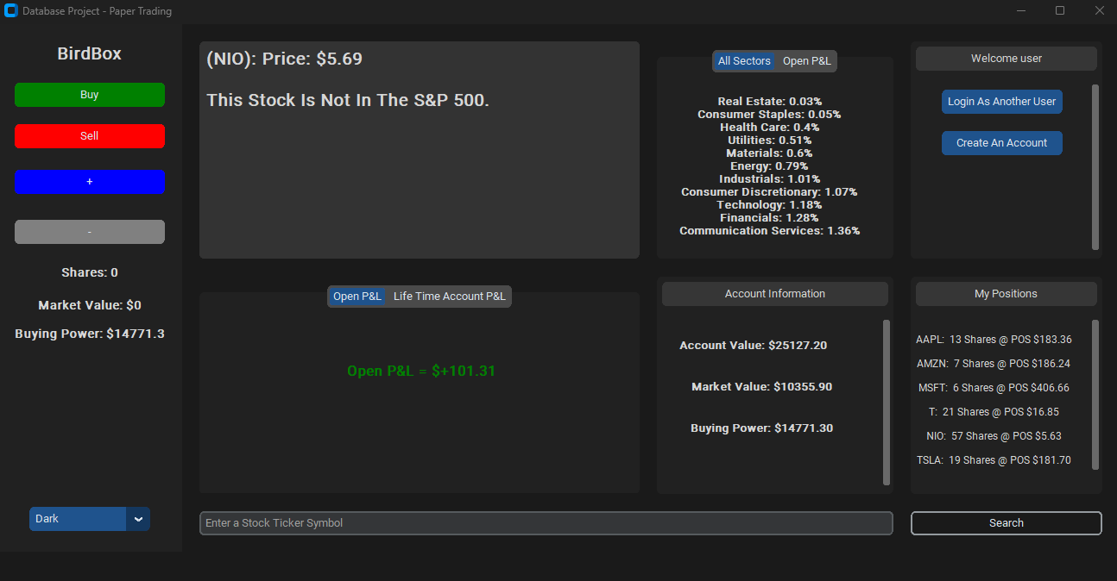
POS Averaging

Slide 16
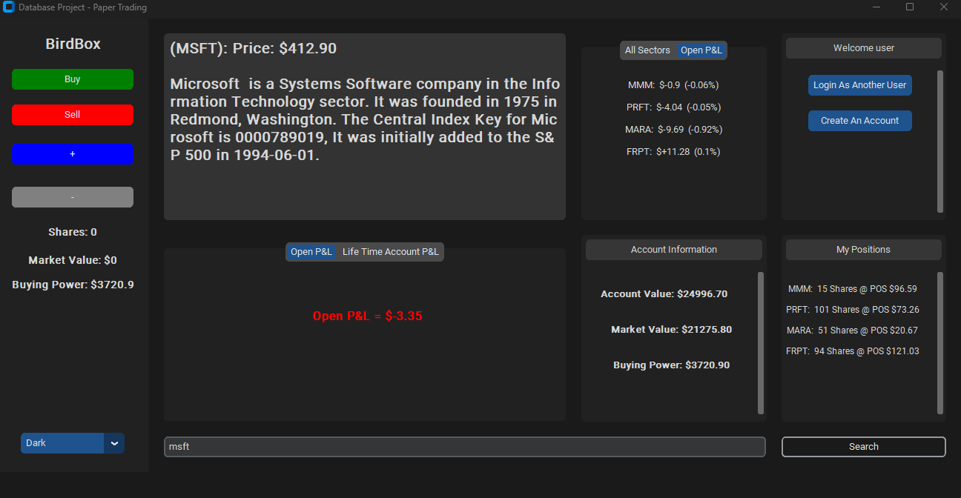


Slide 17
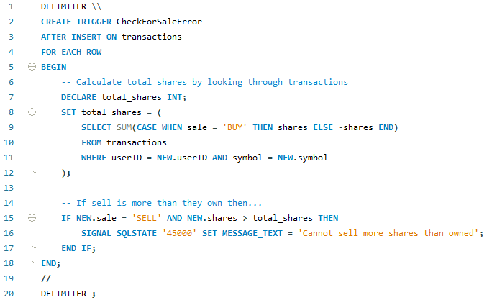
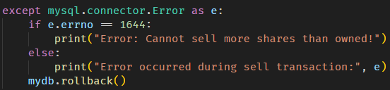


Trigger To Prevent Overselling + Error Handling
Since the main front end needs to be aware that the sell transaction was not completed, I decided to set up a statement to signal to the python code that the user is trying to sell more shares than what they own to ensure the integrity of the database.

Slide 18
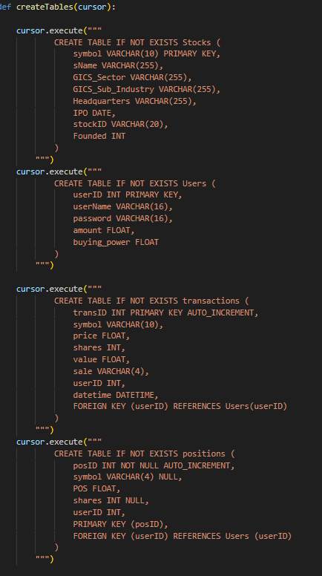
To ensure modular capabilities I added functions in the back end to create the tables in the MySql database application to ensure that the correct tables were being added or else the program would not run correctly on new systems. (Assuming local db specific to new test user)

Slide 19
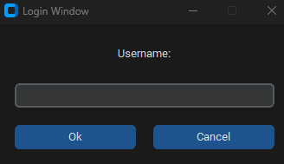
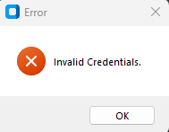
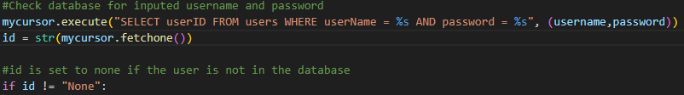
Error Handling
Between the database and python:

Slide 20
Things You Could Add
My Sectors
Latest transactions for user
Wishlist - new table
Portfolio history
PnL graphs
Options Trading / Estimate Calculator

Slide 21
Demo:
(The login window doesn't appear on the screen recording due to it being a separate window and its very laggy on the recording sorry)
https://www.youtube.com/watch?v=6JKEZngruTY&ab_channel=KadenHicklin

Slide 22
Questions?

